Slide 1
SEEK Board Review 10-13-21
Locke

Slide 4
Other options?

Slide 5
Cp-Kpn (Carbapenemase-producing Klebsiella Pneumoniae)
KPC is a type of beta-lactamase encoded on plasmids
Carbapenems are beta-lactams
KPC also confers resistance to cefepime, quinolones, TMP-SMX
KPC has been found in Klebsiella and PsA
Nosocomial; selection thought to have resulted from failure to clean medical equipment (repeat broad spectrum antibiotic exposures)

Slide 6
How does Ceftazidime-Avibactam work?

Slide 7
How does Ceftazidime-Avibactam work?
Ceftazidime – 3rd gen ceph but + ~85% PsA coverage, poor anaerob coverage.
Avibactam – beta-lactamase inhibitor (broader than tazobactam)
Other options:
Meropenem-Vaborbactam, colistin (polymixins)

Slide 8
What is ceftaroline and how is it used?

Slide 9
What is ceftaroline and how is it used?
5th generation Cephalosporin with MRSA/VRSA activity and good gram positive activity. GNR coverage is similar to CTX
Hydrolyzed by KPC

Slide 10
What are the types of beta-lactamases?
 | ESBL | Carbapenemases (subtype of ESBL) | AmpC (inducible, subtype of ESBL)
How to recognize: | GNR – resistant to CTX +/-S to Cefepime (reported) S to meropenem | R to Erta/Mero | SPACE/SPICE-M organism – will appear susceptible but in fact will not be. Can be CTX sensitive on report.
Treatment | Cefepime if susceptible, Mero if not. NOT Zosyn. | Ceftaz-Avibact; Mero-Vaborbact; Colistin | Carbapenem (induces, but not hydrolyzed); Cefepime (doesn’t induce much. But is hydrolyzed so can be ok). NOT Zosyn, CTX.
Serratia marcescens, Providencia, PsA, Citrobacter**, Enterobacter (40%)**, Morganella morganii

Slide 11
GNR Bacteremia with CTX resistance – abx?

Slide 12
GNR Bacteremia with CTX resistance – abx?
NOT AmpC in this study (unless also present with another ESBL, 10%)

Slide 15
Methotrexate, HyperCa neurotoxicity
Weekly MTX: Headache, fatigue, malaise, impaired ability to concentrate
CNS folate metabolism disruption.
Can get acute stroke/seizure-like presentation, but more common with high (chemo) or intrathecal dosing.
Hypercalcemia: anxiety, irritability, depression, cognitive impairment
confusion, stupor, and coma if severe

Slide 16
Sarcoidosis Small Fiber Neuropathy
Destruction of thin myelinated and unmyelinated fibers (nociception, heat, autonomic function)
+Allodynia
Autonomic dysfunction rarely occurs alone.
Exclude DM, B12 def, thyroid
NCS is normal; biopsy specific but not sensitive.
Incidence not well known
Unique: Resistant to pred & methotrexate - ?IVIG and TNF-alpha; symptom management (capsaicin)

Slide 19
How does Dabigatran work?

Slide 20
How does Dabigatran work?
Direct thrombin inhibitor
Not Xa inhibitor!
 | Direct | Indirect (mediated by ATIII)
Xa inhibition | Rivaroxaban Apixaban Edoxaban | Enoxaparin Fondaparinux
Thrombin inhibition | Dabigatran Bivalrudin Argatroban | Unfractionated Heparin

Slide 21
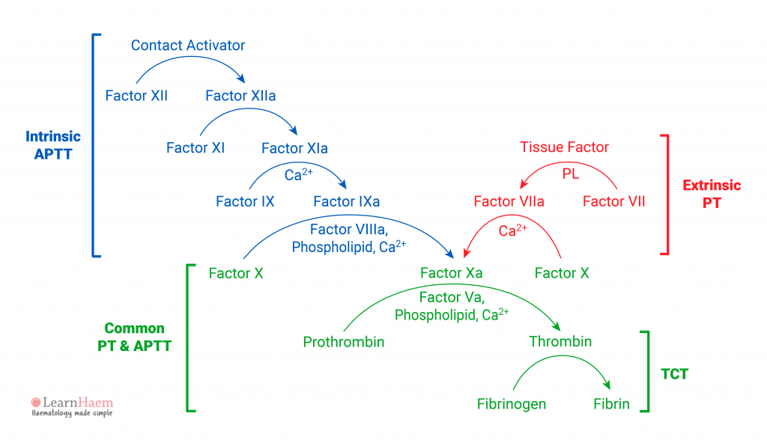

Slide 22
Heparin | Thrombin + Xa inhib | Protamine | Time based: Immediate 1U/100U hep … 120 minutes 0.25u/100u hep
Enoxaparin/Dalteparin | Thrombin inhib | Protamine | <4h – 1mg per 1mg 4-8 – 0.5 mg per 1mg
Fondaparinux | Thrombin inhib | 4F-PCC | 50u/kg
Dabigatran | Thrombin inhib | Idaracizumab | 5 grams IV
Apixaban | Xa inhib | 4F-PCC or Andexanet | 50 u/kg; 400mg then 4mg/min
Rivaroxaban | Xa inhib | 4F-PCC or Andexanet | 50 units/kg; 800 u then 8mg/min
Edoxaban | Xa inhib | 4F-PCC (not andexanet) | 50 units/kg
Warfarin | Vit-k epoxide-reductase inhib | Vit K; FFP; 4F-PCC | Vit K: 2.5-10 mg (use INR) FFP: 15 ml/kg PCC: 2-4 25u/kg, 4-6 35u/kg, 6+ 50u/kg

Slide 23
Idarucizumab (Praxbind)
Dabigatran (Pradaxa) – eliminated by the kidneys
Fab fragment (antibody) that binds dabigatran w/ 350x better affinity than thrombin.

Slide 24
Andaxant Alfa
Decoy Xa (molecular similar) – Xa inhibitors bind to it instead
Unlike factor Xa, it does not convert prothrombin to thrombin
Tested in (direct) Xa inhibitors – Edoxaban, Apixaban, Rivaroxaban
Probably works in enoxaparin too, but not formally evaluated

Slide 25
Protamine
Big positively charged molecule – forms a stable salt with negatively charged heparin
If given alone, protamine is an anticoagulant
If given w/ heparin – will pair up and make the salt.
Also pairs up with enoxaparin/dalteparin, but not quite so effectively.

Slide 26
4F – PCC (K-Centra)
Prothrombin complex concentrate
Factors 10, 9, 7, 2; and protein C and S.
Smaller volume infusion than FFP (15-20mL/kg)

Slide 27
Your patient is bleeding; found down. Lab test to assess AC?
Apixaban: Anti-Xa levels
Dabigatran: Thrombin time, aPTT. NOT INR
Edoxaban: Anti-Xa levels, INR
Rivaroxaban: Anti-Xa levels, INR (50% will have anticoag w/ normal) -> not sufficient to exclude.

Slide 32
Path
Tb – caseating granulomas
Yeast forms:
Cocci – large spherules
Histo – small round spherules within macrophages
Blasto – thick capsule, daughter-buds with broad base
Crypto – similar, but thin base
Sporothrix – small, cigar shaped.

Slide 33
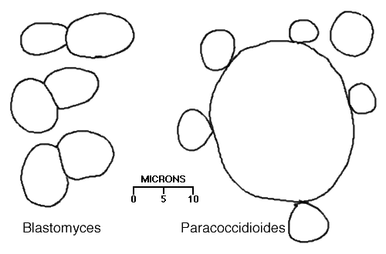
Notes:
https://webpath.med.utah.edu/LUNGHTML/LUNG503.html

Slide 34
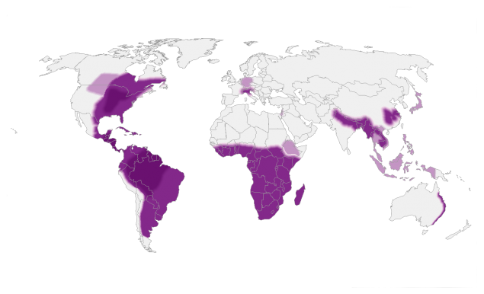
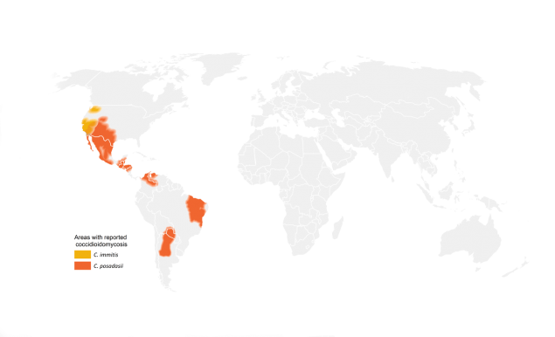
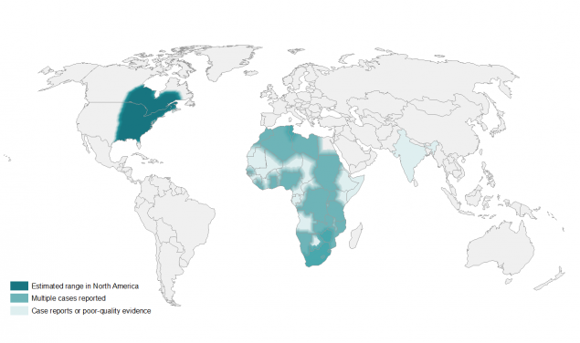
Locations

Slide 35
Locations
Histo
Cocci
Blasto

Slide 36
Dimorphic fungi
Blasto – never colonizer; mainly endemic Ohio and Mississippi river valleys -> grows in moist, decaying organic matter; outbreaks after floods.
Route: inh. All get PNA, then 20% skin, 5% bone, 2% cns
4-8 weeks since inh.
Blast: asymptomatic, pneumonia, extrapulmonary disease
Ampho (if severe) -> Itra

Slide 37
Treatments
Coccidiomycosis | Fluconazole (Ampho if severe)
Blastomycosis | Itraconazole (Ampho if severe)
Histoplasmosis | Itraconazole (Ampho if severe)

Slide 40
Primary graft dysfunction
Within 72h of transplant usually. Assessed at 24/48/72h
Ischemia reperfusion -> ARDS presentation (Diffuse alveolar damage)
Dx of exclusion of other causes of ‘ARDS’, PCWP for congestion, TEE for pulm venous stenosis.
Predisposing conditions
Donor: smoking and aspiration/trauma/undersize
Surgery: cardiopulmonary bypass, large volume transfusion, delayed closure, prolonged ischemic times, increased reperfusion fio2
Recipient: abnormal body weight, pulm htn, COPD/CF
Supportive care, LTVV, Abx, iNO/PG, ECMO.
Retransplant = bad outcomes, not done.

Slide 41
PGD consequences
Increased mortality at 1 year
Increased risk of developing BO-type CLAD
CLAD = chronic lung allograft dysfunction
BO = bronchiolitis obliterans syndrome
No increase in risk of future acute cellular rejection or infection
Not clear if humoral rejection risk influenced

Slide 44
What things cause PaO2-SpO2 gap?

Slide 45
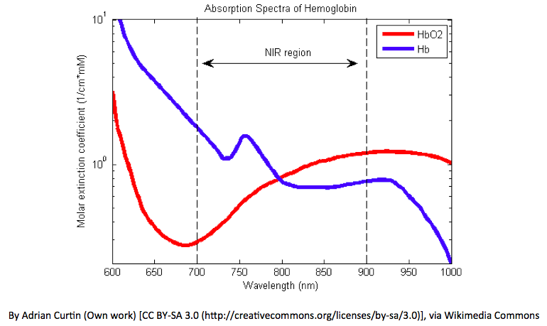
What things cause PaO2-SpO2 gap?
SpO2 = absorption spectrum @ 660 and 940 nm.
Hemoglobinopathy = changes absorption spectrum
iStat = sometimes don’t actually do co-oximetry – they calculate a predicted oxygen saturation.
Need “co-oximetry” - measure oxy-, deoxy-, carboxy-, and methemoglobin

Slide 46
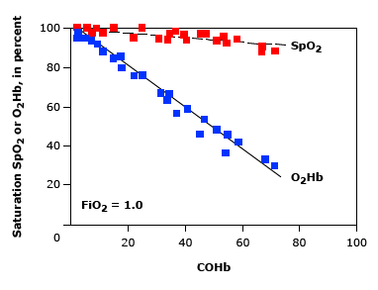
Hemoglobinopathies
Carboxyhemoglobinemia | Methemoglobinemia
95-100% apparent SpO2 | 85% apparent SpO2
COHb = O2Hb | Met-Hb = blue absorption
Sickle hb = no change in absorption spectrum

Slide 47
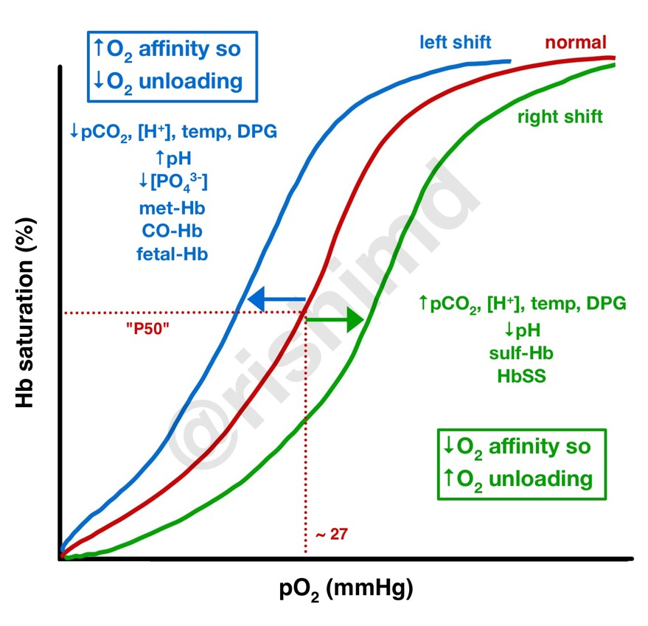
Physiology
Oxidizing agent (electron acceptor) takes Fe++ (Ferrous) to Fe+++ (Ferric) = metHb
Normally, reducing agent (CyB5R) converts it back
Met-Hb, like CO-Hb, binds O2 more tightly. Shifts O2-hb to the left
SpO2 based only on the color of the molecule
O2 Physiology identical to COHb

Slide 48
Why did this patient get Met-Hb?
Oxidizing Agents:
Dapsone
Antimalarials (CQ, Quinones)
Topical anesthetics
iNO, nitrites, nitrates
Anilene Dyes
Metoclopramide

Slide 49
How to treat?
Reducing Agents:
Methylene blue -> cofactor in Fe+++ to Fe++ transition.
Beware in G6PD deficiency this won’t work.

Slide 50
What is Sodium nitrite/thiosulfate used for?
Cyanide poisoning options:
Hydroxycoabalmin – first line, directly binds. 70mg/kg. Interferes w Co-ox
Induction of methemoglobinemia with amyl/sodium nitrite, which can then be reduced. Don’t do this if CO-Hb/Smoke (further reduce O2-Hb availability)
Sulfur donors e.g. sodium thiosulfate turn cyanide to thiocynates which are renally eliminated.
1 and 3 are recommended.

